Slide 1
Tandem Concepts and Facilities

Slide 2
Introduction
Purpose : To familiarise ourselves with the HP NonStop technology
Strictly Private & Confidential

Slide 3
Introduction to NonStop
Technology
What is meant by NonStop technology
Advantages of being NonStop
Concepts of NonStop architecture and fault tolerance
OLTP and batch processing
Basics of NonStop Operating System
TACL
Strictly Private & Confidential

Slide 4
What is Tandem
Tandem platform provides fault tolerant NonStop Systems
Tandem was Compaq NonStop System which is now HP NonStop System
Strictly Private & Confidential

Slide 5
Why Tandem
  NonStop Operations
  Critical operations
  Online trading
  E-Commerce
Strictly Private & Confidential

Slide 6
The advantages of Tandem
Single point fault tolerance
Availability
Scalability
Reliability
Data integrity
Data security
Strictly Private & Confidential
Notes:
Availability includes availability of all components of the system.
Advantages: Competitive edge,24-hr ops,open all hours-cost reduction,round the clock access to money,corporate globalization
future expectations
Availability = uptime/uptime + repair time.
Tandem measures availability as no of minutes of downtime per year.
Downtime cost: $1000 / min

Slide 7
The advantages of Tandem (Continued)
Support for Data mining
Client/server architecture
Interface for heterogeneous n/w systems
Strictly Private & Confidential

Slide 8
Evolution of Tandem
Founded in 1974
RISC K series
S series
Integrity series
Intel Itanium based servers…….
Strictly Private & Confidential

Slide 9
Basic Tandem Architecture
Software Architecture
Hardware Architecture
Strictly Private & Confidential

Slide 10
Software Architecture
Primary Process/Backup Process
ServerNet X/Y fabric
Mirrored disk volumes
EXPAND Subsystem
Strictly Private & Confidential

Slide 11
ServerNet X/Y fabric
CPU 0
CPU 1
CPU 2
CPU 3
ServerNet Interface
X Y
ServerNet Interface
X Y
ServerNet Interface
X Y
ServerNet Interface
X Y
1
2
3
4
5
6
7
8
Strictly Private & Confidential

Slide 12
Mirrored Disk volumes
Checkpoint
SCF(Subsystem Control Facility)
Strictly Private & Confidential

Slide 13
Mirrored Disk volumes
Processor 0 Processor 1
Checkpoint Messages
Mirrored Disks
Primary
Process
Backup
Process
Strictly Private & Confidential

Slide 14
Software Architecture
System A System B
CPU 0 CPU 1 CPU 2 CPU 3
Expand Network
Connection
A
B
C
D
B’
A’
D’
C’
File System
File System
File System
File System
Message System
Message System
Message System
Message System
Dual ServerNet Fabric
Dual ServerNet Fabric
Strictly Private & Confidential

Slide 15
Hardware Architecture
Multiple independent processors
Multiple Power Sources and Online Repair
  Separate source of power for each processor
  The I/O boards containing logic for ServerNet addressable controllers also have separate source of power.
Strictly Private & Confidential

Slide 16
Hardware Architecture
CPU 0
CPU 0
CPU 0
CPU 0
Dual ServerNet Fabric
ServerNet
Adapter
ServerNet
Adapter
ServerNet
Adapter
Strictly Private & Confidential

Slide 17
Introduction to OLTP

Slide 18
OLTP and batch processing
Evolution of OLTP
Requirements of OLTP and its advantages
OLTP support by Tandem
Components involved in Tandem OLTP environment
Strictly Private & Confidential

Slide 19
Evolution of OLTP
Monolithic Model
Requester/Server Model
Client/Server Model
Strictly Private & Confidential

Slide 20
Monolithic Model
Early OLTP applications performed their tasks using the monolithic model. In this model, which is loosely based on the batch processing model, the data input, data manipulation, and data output tasks of an OLTP application are performed by a single program
Additionally, the single program controls all terminals connected to the system and manages communications with other systems
Strictly Private & Confidential

Slide 21
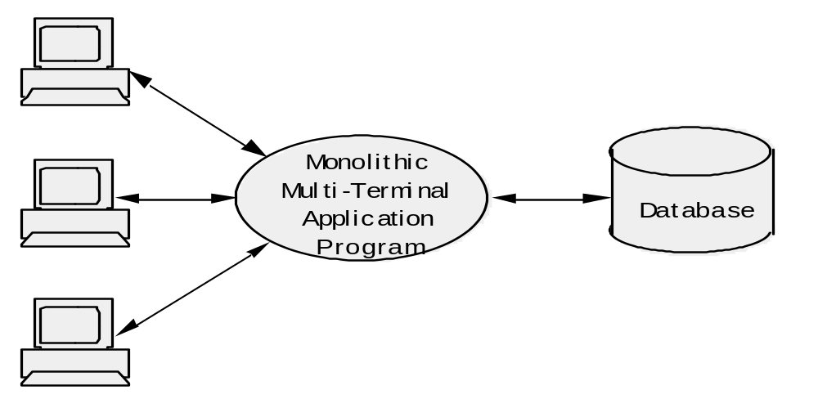
The Monolithic Application Model
Strictly Private & Confidential

Slide 22
Requester/Server Model
Unlike the monolithic model that combines data input, data manipulation, and data output into one program, the requester/server model divides those three tasks between two basic processes, requesters and servers
Strictly Private & Confidential

Slide 23
The Requester/Server Model
Accept Commands Display Screens Read Data Write Data
and Data
Send Requests
Send Replies
DOS
OS2
OS2
Reservations
Database
Requester Program
Server Program
Strictly Private & Confidential

Slide 24
Client/Server Model
The Client Server applications model in Tandem allows us to connect Tandem with other operating environments. This allows for sharing of tasks between the constituent operating systems
Strictly Private & Confidential

Slide 25
The Client/Server Model
DOS
OS2
NonStop
SQLMP
Database
Server
Program
SUN
Strictly Private & Confidential

Slide 26
Requirements of OLTP
High-volume throughput
Concurrent transaction processing
Database integrity
Database consistency
Application expandability
Strictly Private & Confidential

Slide 27
Advantages of OLTP
Improved Customer Service
Up-to-date data for decision making
Strictly Private & Confidential

Slide 28
OLTP support by Tandem
High-volume throughput
  Multiprogramming and multiprocessing
  Efficient resource-queue management
  Reduced virtual memory paging between main memory and disk
  Residence of critical portions of the operating system in main memory
  Powerful, efficient management of disk I/O processing
Strictly Private & Confidential

Slide 29
OLTP support by Tandem
Concurrent transaction processing
  Rapid Response Time
  Specialized Application Modules
  Multiple Requesters and Servers
  Load Balancing
Strictly Private & Confidential

Slide 30
OLTP support by Tandem
Database integrity
  Structural integrity for files
  Storage-media protection
  Data-sharing protection
  EXPAND data communication software
  Mirrored disks and the Remote Duplicate Database Facility (RDF)
Strictly Private & Confidential

Slide 31
OLTP support by Tandem
Database consistency
  TMF
    Concurrency control
    Failure
Application expandability
  Local and Locally Distributed Databases
  Global Database
Strictly Private & Confidential

Slide 32
Components involved in tandem OLTP environment
PATHMON - Pathway Monitor
TCP - Terminal Control Process
PATHCOM - Interface
LINKMON - Link between Requester and Server
ROUTER - A program that routes the communication between other programs
PATHSEND -Replaces TCP for external systems
Strictly Private & Confidential

Slide 33
Different Languages available on Tandem
TAL (Transaction Application Language)
COBOL85
C/C++
Pascal
BASIC
TACL (Tandem Advanced Command Language)
Strictly Private & Confidential

Slide 34
Thank You
Strictly Private & Confidential

